Slide 1
IO3 – E-book Creation and Training
Teacher’s Webinar Training

Slide 2
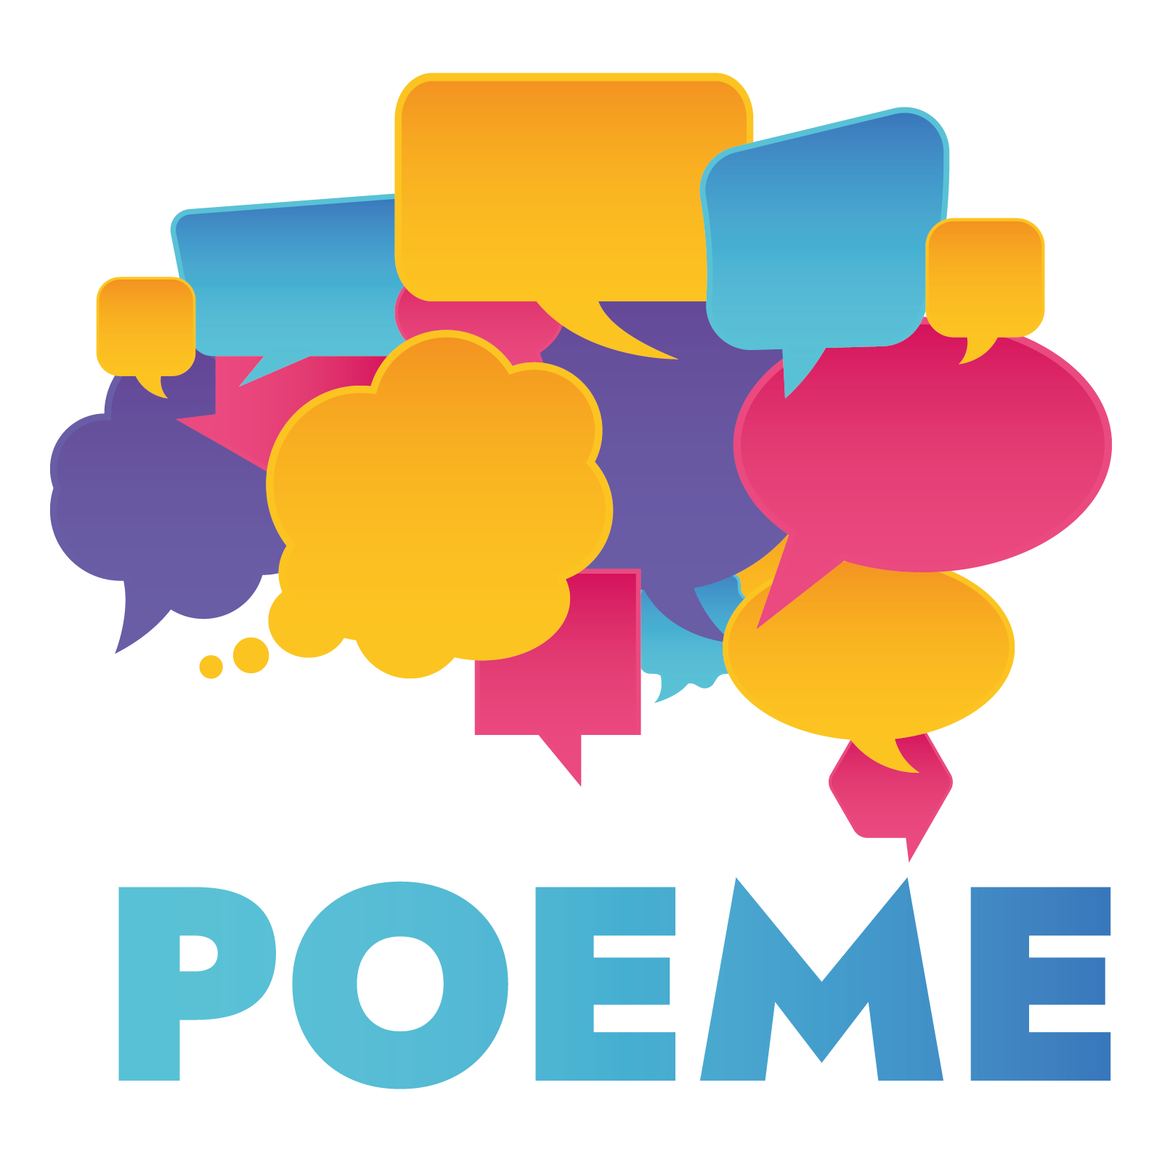
Content of the webinar
1 – Project Presentation
Partners
Project goals
Project Intellectual Outputs
2 – Creating e-books
Pedagogical part – why use e-books?
Technical part – using software to build e-books

Slide 3
What is POEME?

Slide 4
Partners
France
Belgium
Portugal
Greece
Cyprus
Greece

Slide 5
Project Goals
The main goals of the POEME Project are:
The modernization of second language teaching both in content (European Cultural Heritage) and form (using digital tools), and the creation of blended learning exhibitions by students
Empowerment of educators and students with digital and soft skills
This will build linguistic and cultural wealth, while contributing to the inclusion of migrant students
in the host culture.
The project aims to provide linguistic support to students in any of the four languages of the consortium
(EN, FR, PT, EL).

Slide 6
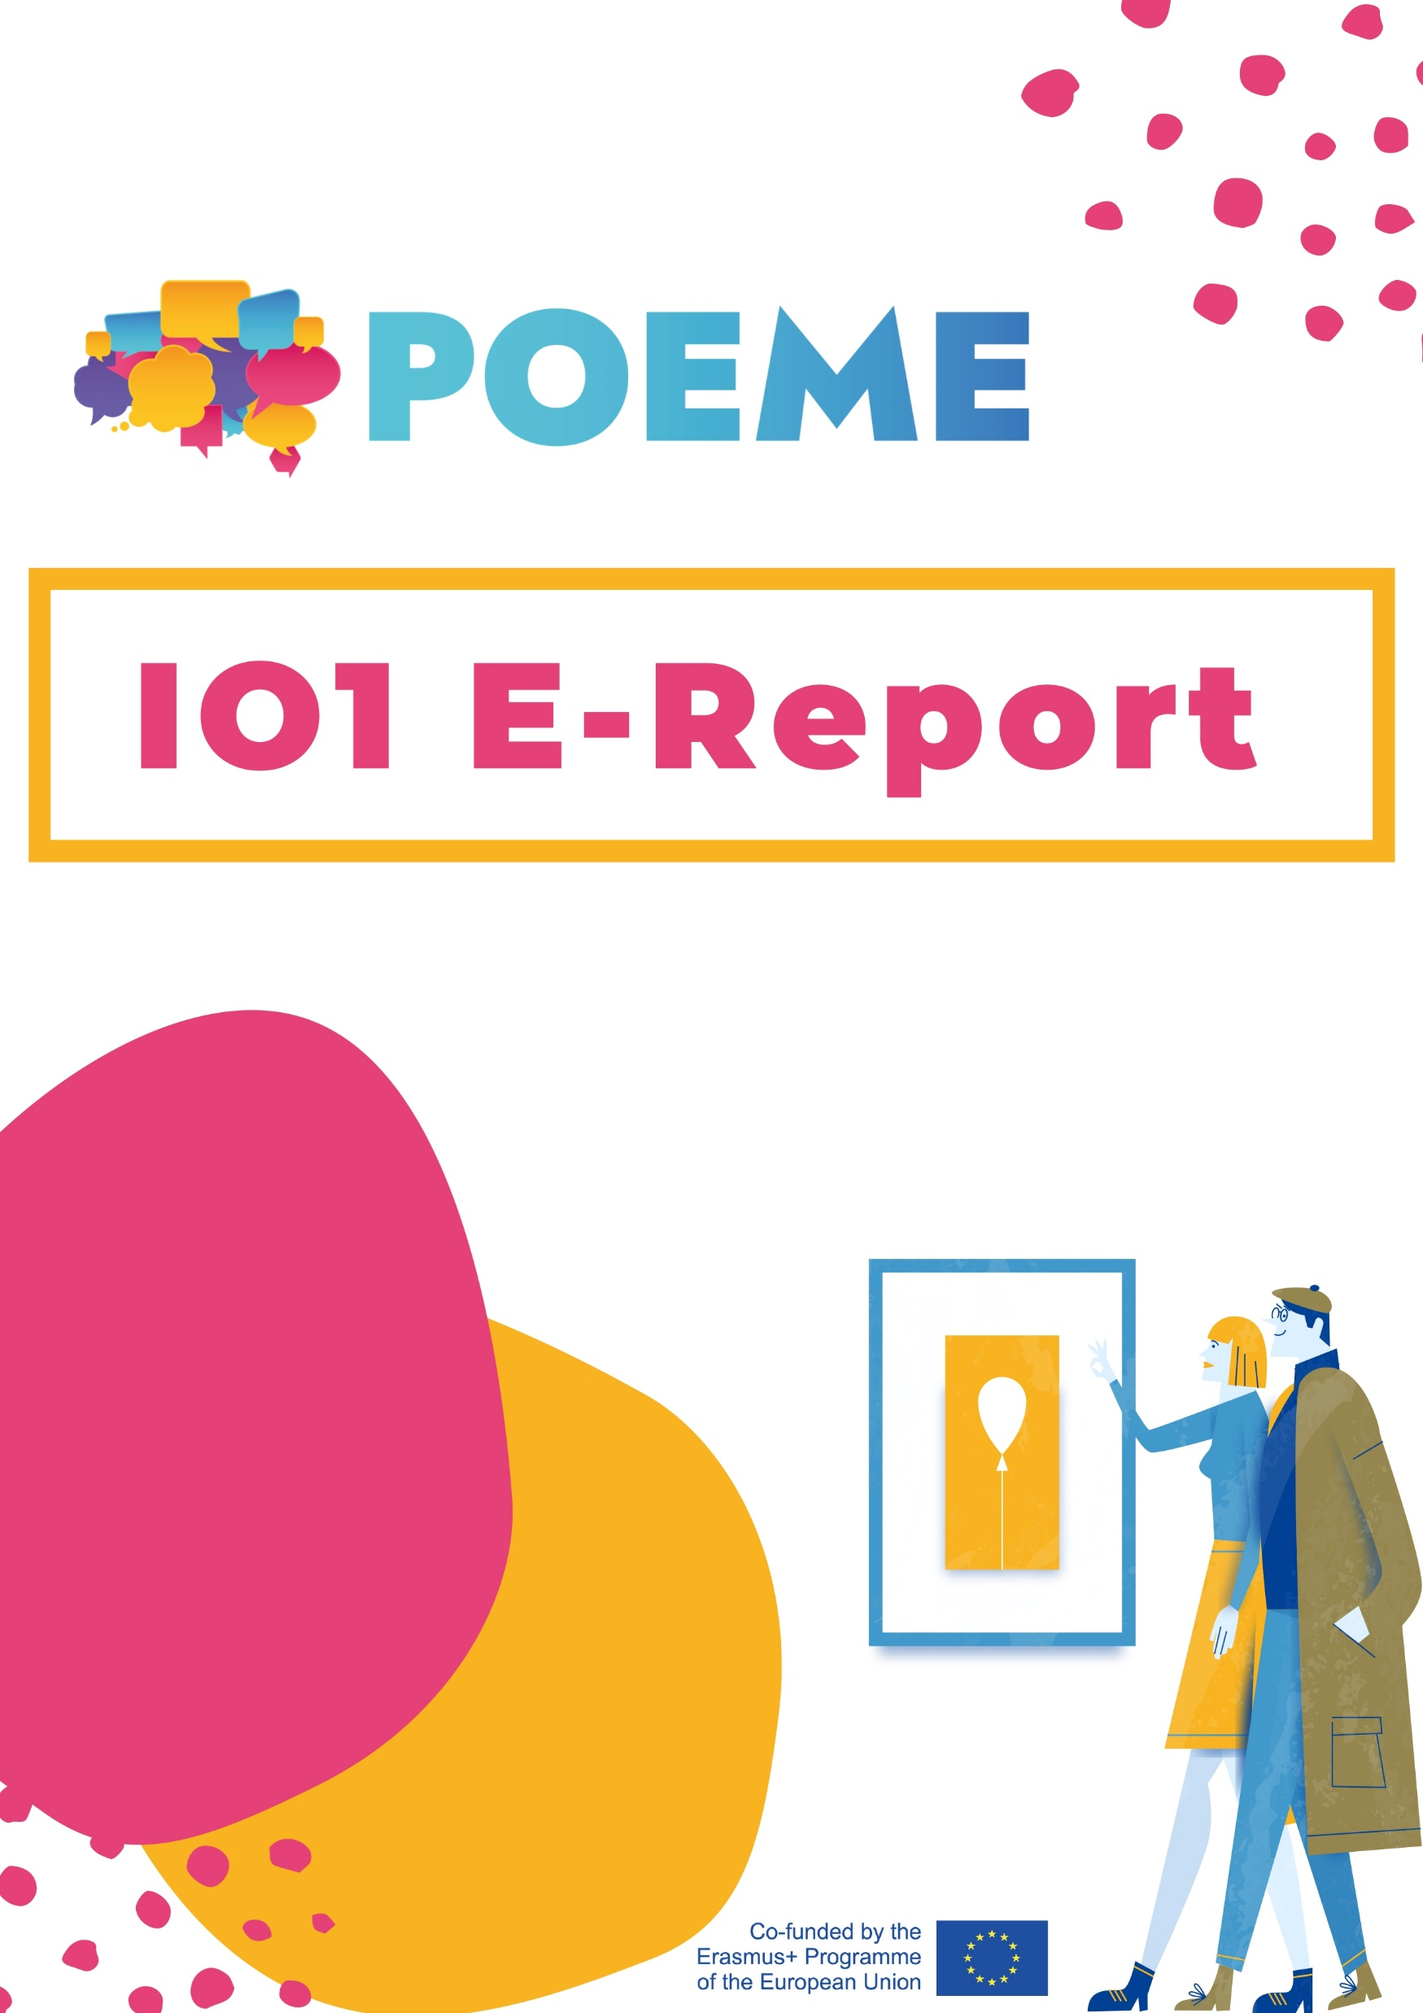
Project Results
IO1
The POEME E-Report
It sets a theoretical framework for all of the results of the project, highlighting:
The value of nonformal teaching methods;
The possibilities offered by the use of e-worksheets and e-books for second language teaching,
The value of integrating elements of European cultural heritage and blended learning exhibitions as pedagogical tools.

Slide 7
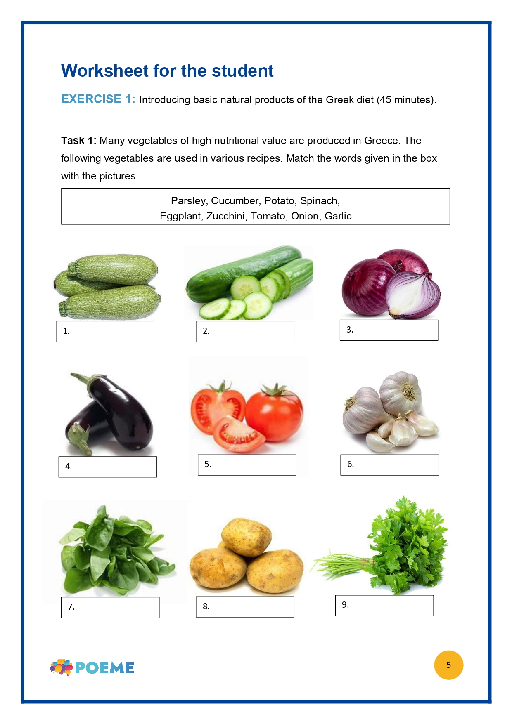
Project Results
IO2
The POEME E-Worksheets
Each partner produced 3 worksheets in English, 18 worksheets in total, which were translated into the languages of the partnership.
Target group: students from 12 to 18 years old
Topic: Elements of tangible, intangible, natural and digital cultural heritage.

Slide 8
Project Results
IO3
IO4
The POEME E-Books
The POEME E-Guidebook for POEME exhibitions
10 e-books were created, based on the topics of European Cultural Heritage
Each e-book is presented in three difficulty levels.
The e-books are visually appealing and interactive, containing voice-overs of the stories, as well as definitions of difficult words
This IO includes a webinar with the aim of webinar on how the teachers could use software to build e-books.
It will be an interactive pedagogical tool that will build on the previous IOs and invite peer students, with the guidance of educators, to work collaboratively in curating a blended (digital or physical) exhibition on cultural heritage, giving them the tools to do so.

Slide 9
Project Results
IO5
The POEME Blended Learning Exhibitions
The POEME blended (digital or physical) exhibitions on cultural heritage will put in practice the skills acquired in the previous IOs.
Students will act as curators, planning and creating the exhibitions.
Each partner will be responsible for creating one tailor-made digital or physical exhibition, by following each of the components presented in the IO4 interactive e-guidebook.
The blended learning exhibitions, which will first be created in English and at a later point will be translated into French, Greek and Portuguese.
They will operate both as readymade samples to be viewed and explored (in case of digital exhibitions) or downloaded and printed (in case of physical ones) through “The POEME Digital Gallery”.
Image source: freepik.com

Slide 10
The POEME project in numbers:
1 E-Report in EN, translated to French, Portuguese and Greek
18 e-Worksheets in EN with topic of European cultural heritage, translated to FR, PT and EL
10 Interactive e-books, translated to FR, PT and EL
6 blended exhibitions, forming the POEME Digital Gallery, translated to FR, GR and PT
200 students participating in the development of the POEME blended exhibitions
15 participating teachers per consortium language

Slide 11
E-book creation Pedagogical Part

Slide 12
Why e-books?
E-books have a number of interactive elements, like: audio, videos, animations, quizzes, widgets, interactive questions and polls
Simple design and easy-to-use layout
Different functionalities, such as: the “recently viewed” function, the “universal search” function, the “bookmark” function, the “notes” function
Notes:
The functionalities, as well as the interactive elements result in an e-book that is visually appealing and easy to use.

Slide 13
Using e-books in learning activities
E-books can be used as in a group activity or individually:
For example:
In classrooms - learners can create their own e-books, or use the one created by their teacher to learn more about certain topic
As homework - learners can create their own e-books following a lesson in the classroom
Flipped classroom approach
E-books do not need to be replicas of the print books → space for creativity and imagination while using different tools
Lastly, e-books can be really fun for learners and great way to keep them motivated

Slide 14
Exploring cultural heritage through e-books
The approach of the POEME project to second language acquisition is primarily focused on the exploration of other countries’ cultures.
This will push students out of their comfort zone – linguistically and geographically – and will better understand the cultural reality in which their local peers function.
We believe that this way of approaching second language acquisition will bring a lot of benefits to the students, by allowing them not only to learn a second language, but also about the European cultural heritage.
We suggest you try this approach as well when developing e-books!

Slide 15
E-book creation Technical Part

Slide 16
What kinds of e-books are there
There are many possible options to create e-books, For example: Sigil, Pub coder, Book Creator
E-books come in different formats:
ePub (standard format, readable in many devices)
PDF (not e-reader friendly)
BBeB
DJVU
DOC, etc
Image source: freepik.com

Slide 17
Book Creator
Before creating the e-book, we recommend:*
Prepare the content (text, image, sound);
Use royalty-free images and sound
Book Creator

Slide 18
Book Creator
Step 1: Sign in as a teacher

Slide 19
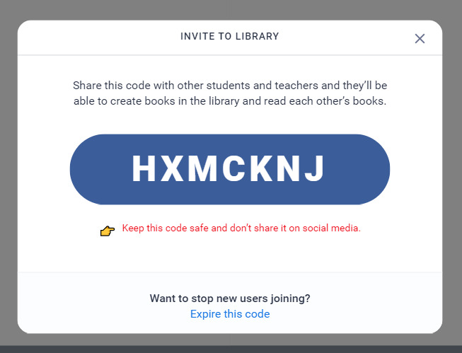
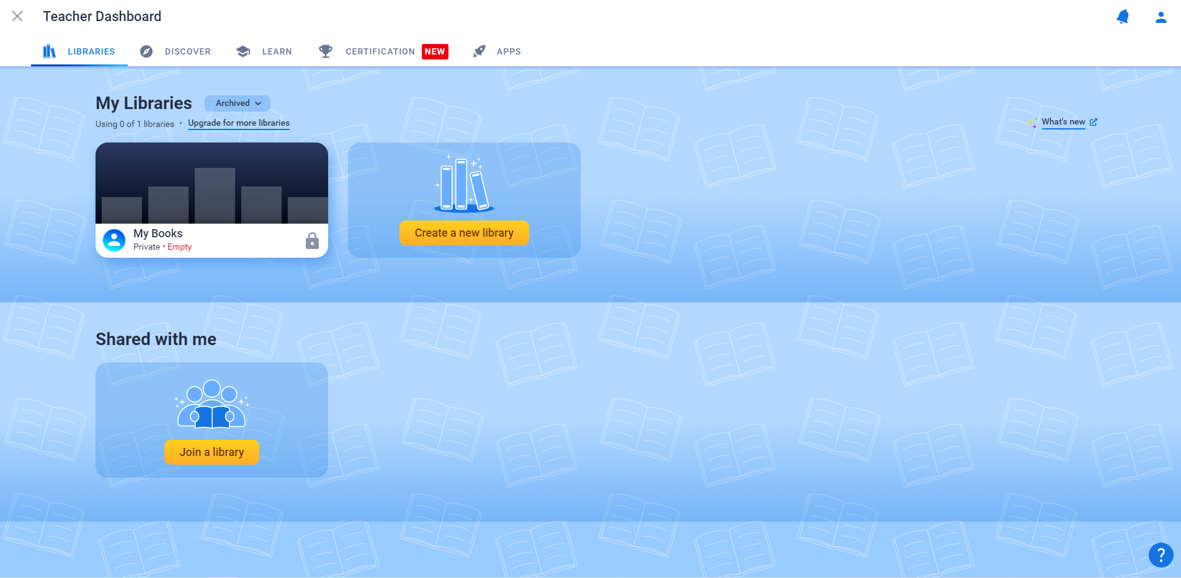
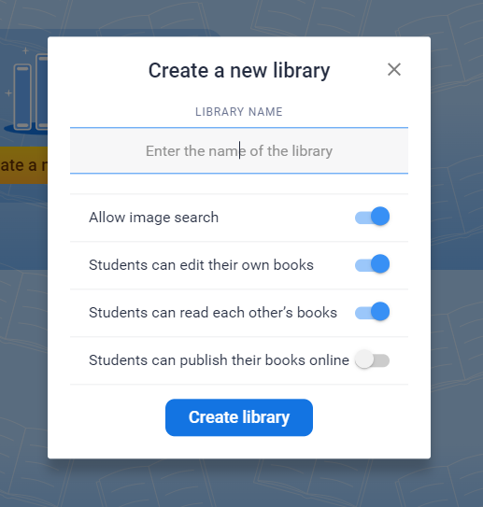
Book Creator
Step 2: Create a new library
Important: in the free version you can only have one library
THE CODE
Notes:
The dashboard
Click on create new library
Add name
Click on „create”
Library appears on the dashboard
You can invite others to join you in your library and create their books
You can only have one library – but you can create 40 books in that one library

Slide 20
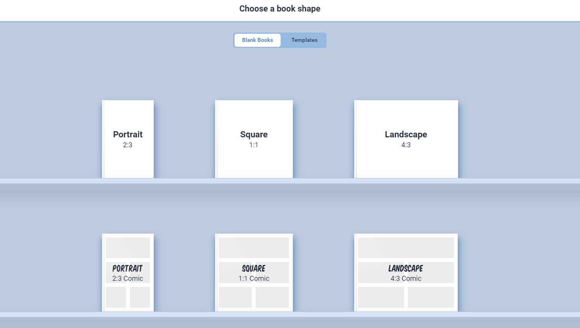
Book Creator
Step 3: Create new book

Slide 21
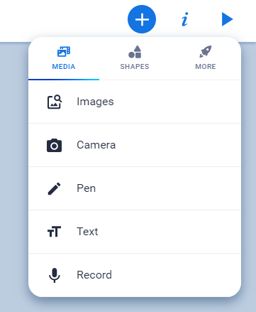
Book Creator
Step 4: Create the cover page
Notes:
To create a cover page you can add shapes, images, or just simple text by clicking on the + sign in the right corner
When you choose a shape, for example, and you want to change the color of it/change the font of the text– you will have to click on the little i in the corner

Slide 22
Book Creator
Step 5: Create the rest of the book
Notes:
Once you are done with the cover page, simply click on the right arrow to move on the next page
Then, the new page will appear on the screen and you can edit it as you wish
You can also add the sound – the recording of your voice, for example, to the ebook
Add as many pages as you need, and decorate them as you want

Slide 23
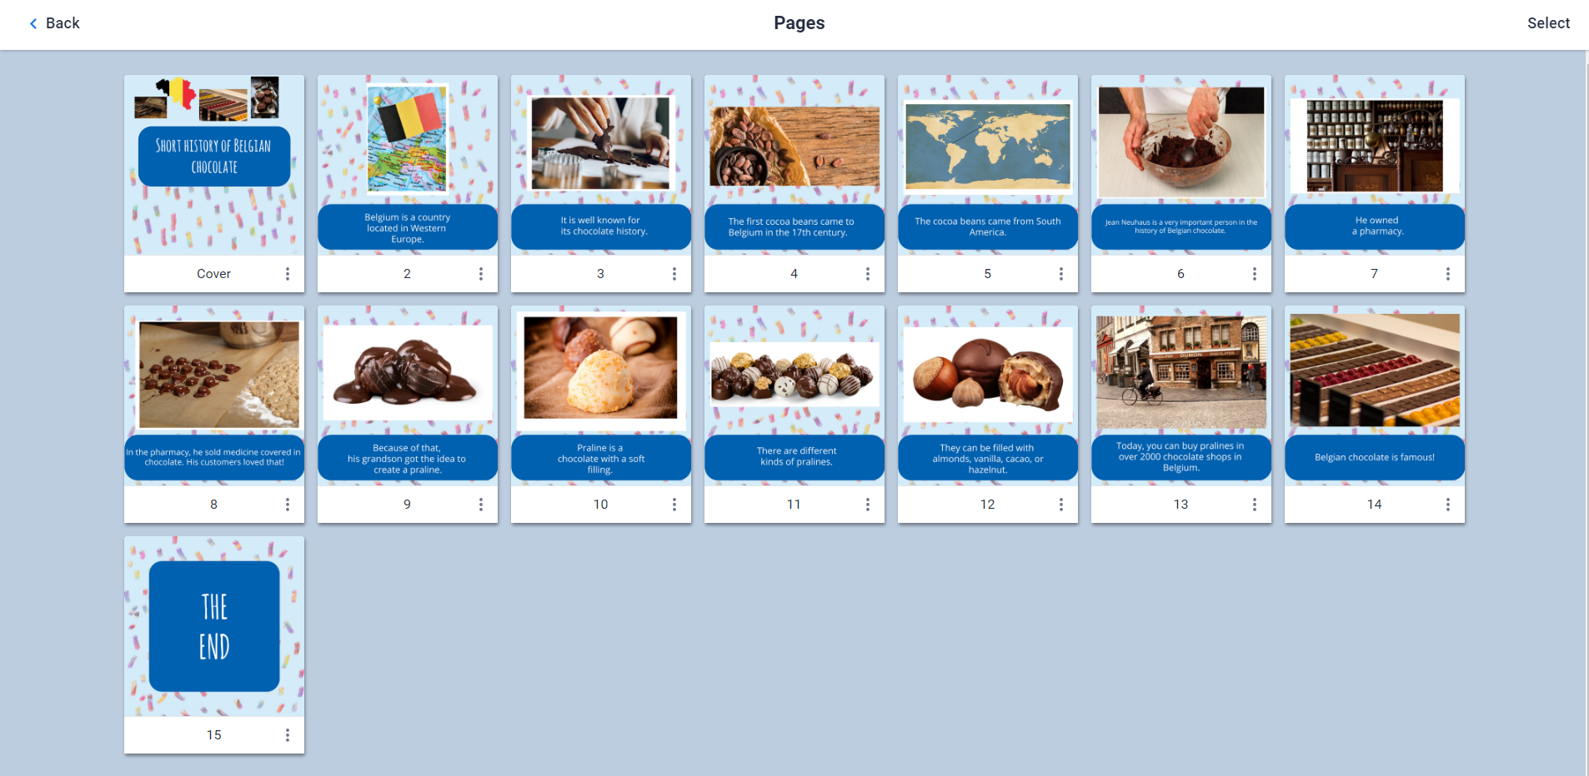
Book Creator
Step 6: Finalisation
Notes:
To see all the pages click on „pages”
Here you can see all the pages, change the order, delete the pages or copy them

Slide 24
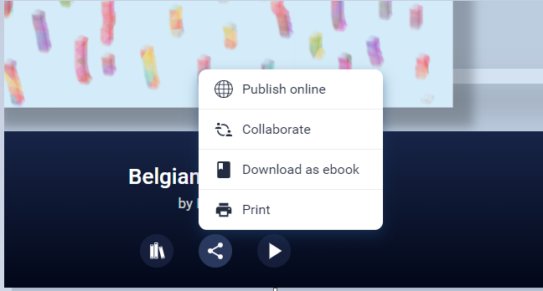
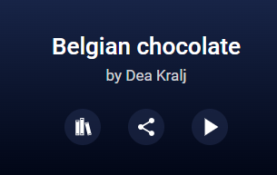
Book Creator
Step 7: Download the e-book
Notes:
Then, you can download your file by clicking on „Download as ebook” and, it is automatically saved in the ePub format.
You can open your ePub with a reading application (eBook Reader, Apple Books for example).
You can also publish it online – on the book creator, or just simply use it and read it as it is by clicking on the „play” button
If you decide to play the book, you can also choose the „read to me” option for read aloud, even if you didn’t record your voice previously
And, that’s it, enjoy your ebook!

Slide 25
How to open ePub files?
The downloaded e-book will be in ePub format → you can open it with a reading application (Apple Books or Thorium, for example)
Notes:
Then, you can download your file by clicking on „Download as ebook” and, it is automatically saved in the ePub format.
You can open your ePub with a reading application (eBook Reader, Apple Books for example).
You can also publish it online – on the book creator, or just simply use it and read it as it is by clicking on the „play” button
If you decide to play the book, you can also choose the „read to me” option for read aloud, even if you didn’t record your voice previously
And, that’s it, enjoy your ebook!

Slide 26
Questions and feedback
https://www.menti.com/
Code: 2462 8286
https://bit.ly/POEME_Feedback

Slide 27
Thank you!
Check out the POEME website and social media:
 www.poemeproject.eu
www.facebook.com/POEMEproject
The European Commission's support for the production of this publication does not constitute an endorsement of the contents, which reflect the views only of the authors, and the Commission cannot be held responsible for any use which may be made of the information contained therein.

