Slide 1
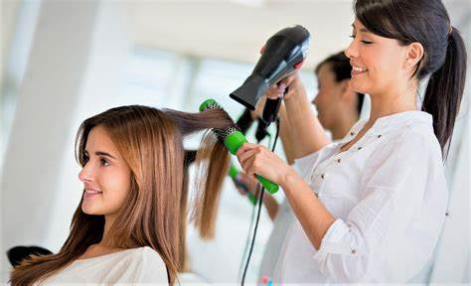
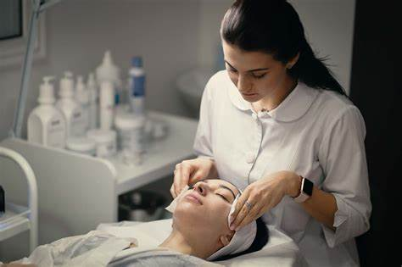
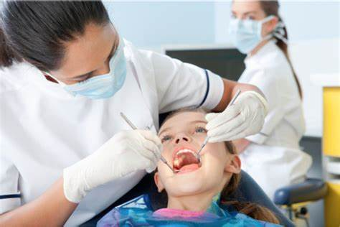
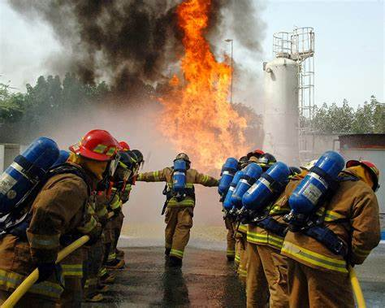
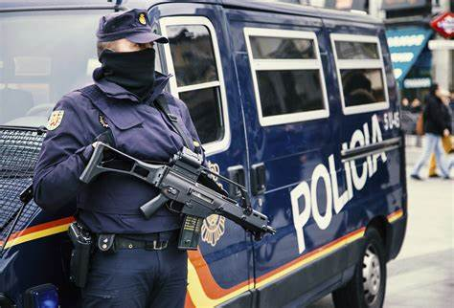
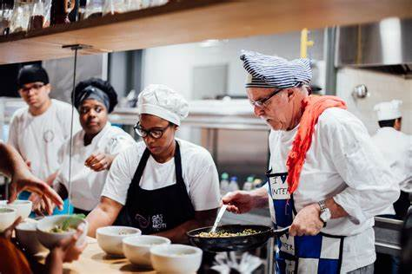


Present professions

Slide 2
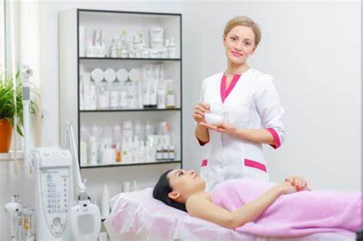
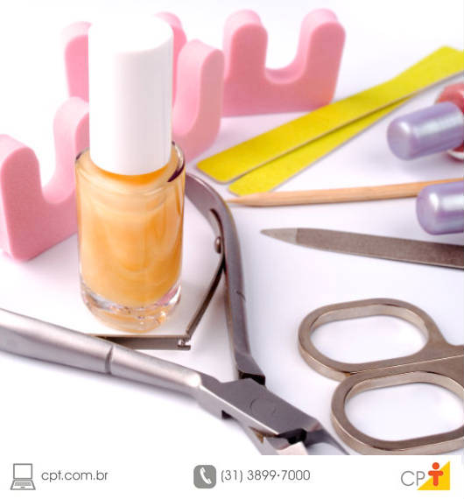
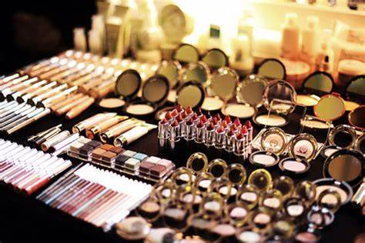
Beautician
An beautician is a trained beauty care and wellness professional who focuses on improving the physical appearance and health of a person's skin.

Slide 3
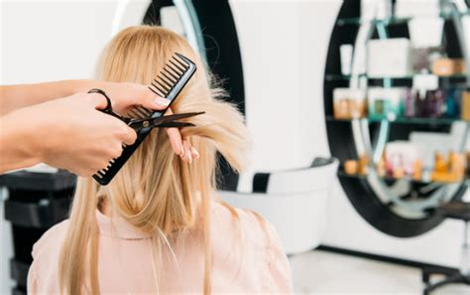
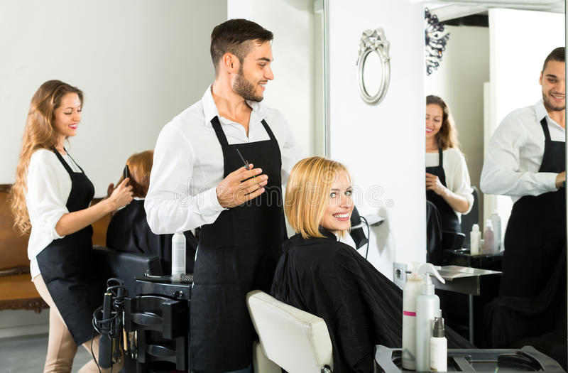
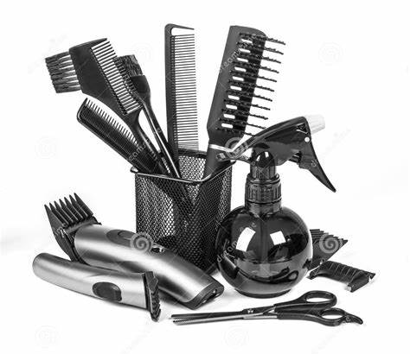
Hairdresser
A hairdresser is a hair professional and, as you already know, is responsible for taking care of other people's hair. This care includes: cutting, painting, styling, waving, straightening, applying wigs, among others.

Slide 4
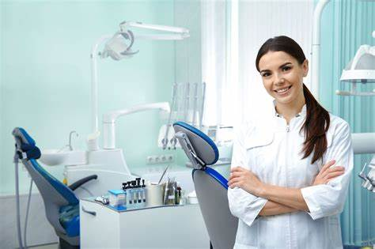
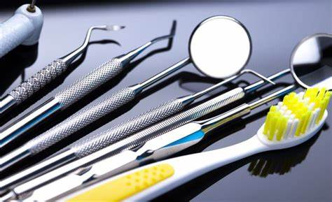
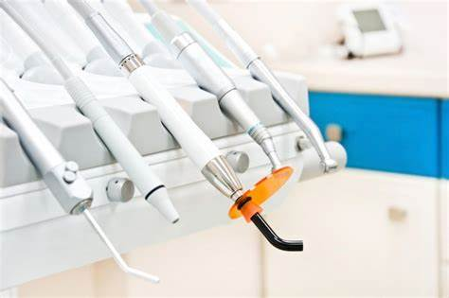
Dentist
A dentist does the process of extracting teeth, filling, cleaning, placing dentures, treating cavities, installing and maintaining dental braces, surgeries and the treatment of various diseases.

Slide 5
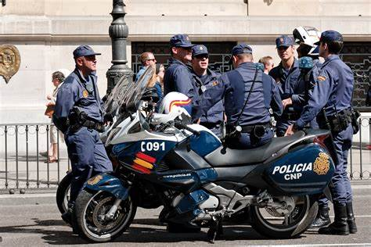
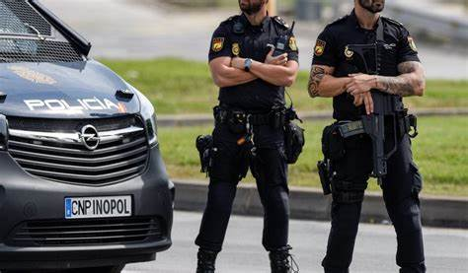
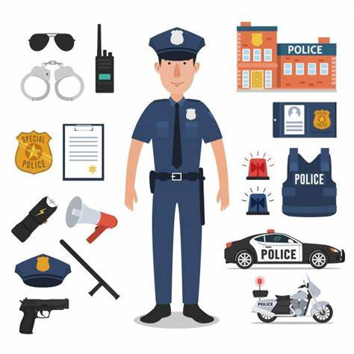
Police
It carries out constant patrols of roads, guides the population, contains civil disturbances, carries out actions to search for criminals and recover property, attends to occurrences such as traffic accidents, fights, robberies and other disturbances.

Slide 6
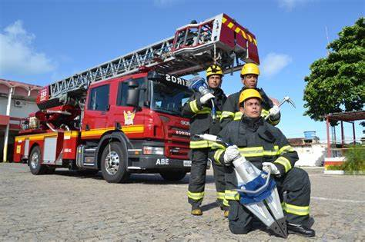
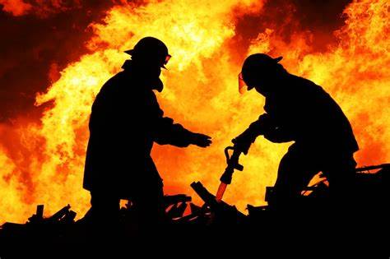
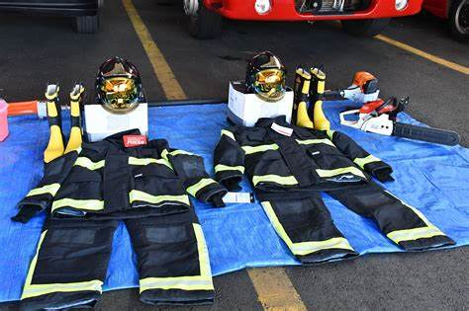
Firefighter
At first, the firefighter worked only in firefighting. However, as time went by, the activities were redefined and other functions are now part of the firefighter's day-to-day life.

Slide 7
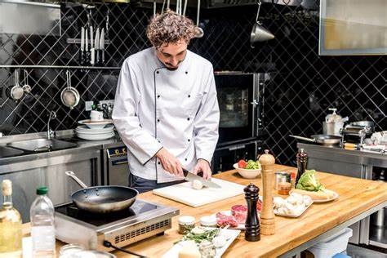
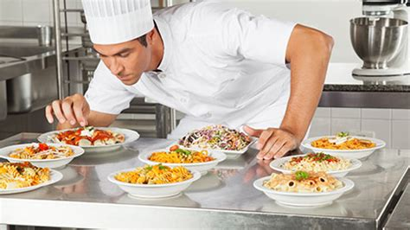
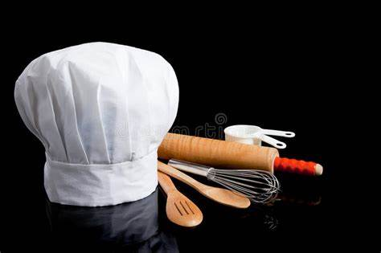
Cook
The cook is the professional who prepares dishes in the kitchen. He prepares all kinds of dishes, from main meals, to starters, snacks, desserts, salads, soups and creams, side dishes, among others.

Slide 8


